Slide 1
Orchestrating Data and Services with Azure Data Factory
Sonia Carlson | Principal Program Manager
Pete Harris | Senior Content Developer

Slide 2

Meet Sonia Carlson
Principal Program Manager, Azure Data Factory
Worked on the Data Factory engineering team since it’s inception. She previously worked on the Azure Machine Learning team
15yrs experience in data analytics and software development

Slide 3

Meet Pete Harris | ‏@peteatmsft
Senior Content Developer, Microsoft LeX
Data & application platform content developer
Over 20 years of industry experience
Training, documentation, community, program management, software development

Slide 4
Course Topics
Orchestrating Data and Services with Azure Data Factory
01 | Data Orchestration Overview
02 | Data Factory Concepts
03 | Data Factory Operations
04 | Monitoring and Managing
05 | Extending Data Factory
06 | Data Factory and other services

Slide 5
01 | Data Orchestration Overview
Sonia Carlson | Principal Program Manager
Pete Harris | Senior Content Developer
Notes:
In this module you’ll learn the basic concepts of data orchestration. You’ll learn about how data analytics is evolving, what Microsoft’s cloud analytics suite can do, and how Azure Data Factory is used to automate the movement and transformation of data.

Slide 6
Module Overview
Traditional Analytics Platforms
Evolving Approaches to Analytics
Azure Data Factory Overview
Cortana Analytics Suite and Data Factory
Why Data Factory?

Slide 7
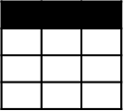
Traditional Analytics Platforms
Extract
Transform
Load
EDW
(SQL Svr, Teradata, etc)
OLTP
…
ETL Tool
(SSIS, etc)
Transformed Data
BI Tools
Original Data
ERP
LOB
Data Marts
Data Lake(s)
Dashboards
Apps

Slide 8
Evolving Approaches to Analytics
Extract
Transform
Load
EDW
(SQL Svr, Teradata, etc)
OLTP
…
ETL Tool
(SSIS, etc)
Transformed Data
BI Tools
Original Data
ERP
LOB
Data Marts
Data Lake(s)
Dashboards
Social
Ingest (EL)
Apps
Devices
Scale-out Storage & Compute
(HDFS, Blob Storage, etc)
Sensors
Original Data
Web
Streaming data
Transform & Load

Slide 9
Evolving Approaches to Analytics
Extract
Transform
Load
EDW
(SQL Svr, Teradata, etc)
OLTP
…
ETL Tool
(SSIS, etc)
Transformed Data
BI Tools
Original Data
ERP
LOB
Data Marts
Data Lake(s)
Dashboards
Social
Ingest (EL)
Apps
Devices
Scale-out Storage & Compute
(HDFS, Blob Storage, etc)
Sensors
Original Data
Web
Streaming data
Transform & Load

Slide 10
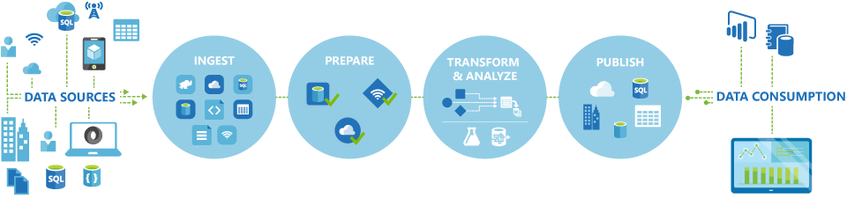
Azure Data Factory
A managed cloud service for building & operating data pipelines
Part of the Cortana Analytics Suite

Slide 11







Cortana Analytics Suite Transform data into intelligent action
Information Management
Big Data Stores
Machine Learning and Analytics
Dashboards and Visualizations
Business apps
Power BI
Azure
Data Factory
Azure
Machine Learning
Personal Digital Assistant
Azure
Data Lake store
Cortana
Azure Data Lake analytics service
People
Custom apps
Azure
Data Catalog
Perceptual Intelligence
Azure HDInsight
(Hadoop and Spark)
Face, vision
Azure
SQL Data Warehouse
Speech, text
Azure
Event Hub
Azure
Stream Analytics
Business Scenarios
Sensors and devices
Recommendations,
customer churn,
forecasting, etc.
Automated Systems
DATA
INTELLIGENCE
ACTION
Notes:
Cortana Analytics Suite delivers an end-to-end platform with integrated and comprehensive set of tools and services to help you build intelligent applications that let you easily take advantage of Advanced Analytics.
First Cortana Analytics Suite provides services to bring data in, so that you can analyze it. It provides information management capabilities like Azure Data Factory so that you can pull data from any source (relational DB like SQL or non-relational ones like your Hadoop cluster) in an automated and scheduled way, while performing the necessary data transforms (like setting certain data colums as dates vs. currency etc). Think ETL (Extract, Transform, Load) in the cloud. Event hub does the same for IoT type ingestion of data that streams in from lots of end points.
The data brought in then can be persisted in flexible big data storage services like Data Lake and Azure SQL DW.
You can then use a wide range of analytics services from Azure ML to Azure HDInsight to Azure Stream Analytics to analyze the data that are stored in the big data storage. This means you can create analytics services and models specific to your business need (say real time demand forecasting).
The resultant analytics services and models created by taking these steps can then be surfaced as interactive dashboards and visualizations via Power BI
These same analytics services and models created can also be integrated into various different UI (web apps or mobile apps or rich client apps) as well as via integrations with Cortana, so end users can naturally interact with them via speech etc., and so that end users can get proactively be notified by Cortana if the analytics model finds a new anomaly (unusual growth in certain product purchases- in the case of real time demand forecasting example given above) or whatever deserves the attention of the business users.

Slide 12










Cortana Analytics Suite: use cases
Marketing campaign analysis
User and product profiling
Customer sentiment analysis
Personalized product recommendation
Customer shopping behavior analysis
Interactive Entertainment
Interactive Entertainment/Retail
Interactive Entertainment/Retail
Retail
Retail
Pricing optimization
Corrective and predictive maintenance and repairs
Operational telemetry and health reporting
Actuarial modelling and reporting automation
Financial risk modelling and analysis
Retail
Manufacturing (IOT)
Online Services
Financial Services
Financial Services
Notes:
When you have a system that can blend both approaches and handle the amounts, types, and speed of data today, it let’s you focus on analytics for your business, you can have amazing transformations and gain a competitive edge.
Story – Retail/Furniture store with sensors

Slide 13
Why Data Factory?
Orchestrate, monitor & schedule data pipelines
Compose data processing, storage, and movement services (on-premises and cloud)
Operate on a recurring schedule
Automatic cloud resource management
Globally available data movement capability
Intelligent job-based resource management
Single pane of glass
One place to manage and monitor data pipelines

Slide 14
02 | Data Factory Concepts
Sonia Carlson | Principal Program Manager
Pete Harris | Senior Content Developer
Notes:
This this module you’ll learn about the specific components in an Azure Data Factory. You’ll get an overview of the methods for bringing data in to your data factory, how that data can be transformed with activities, and how those activities are manages by pipelines.

Slide 15
Module Overview
Data Sources, Linked Services & Datasets
Activities
Pipelines
Supported data sources
Supported activity types

Slide 16
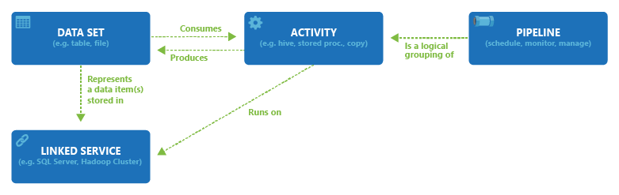
Data Sources, Linked Services & Datasets

Slide 17
Activities

Slide 18
Pipelines

Slide 19
03 | Data Factory Operations
Sonia Carlson | Principal Program Manager
Pete Harris | Senior Content Developer
Notes:
In this module you’ll learn how to create and operate a data factory. You’ll see a demonstration of how to create all the pieces of a simple data factory to automate the movement and transformation of data.

Slide 20
Module Overview
Demo: Creating a Data Factory
Demo: Deploying data pipelines
Demo: Scheduling Pipelines and Partitioning Data
One-time pipelines

Slide 21
04 | Monitoring and Managing
Sonia Carlson | Principal Program Manager
Pete Harris | Senior Content Developer

Slide 22
Module Overview
Demo: Product Recommendations
Managing & Monitoring
Activity windows
Troubleshooting
Creating Alerts on events and metrics

Slide 23
05 | Extending Data Factory
Sonia Carlson | Principal Program Manager
Pete Harris | Senior Content Developer

Slide 24
Module Overview
Visual Studio extension
Azure Management SDK and PowerShell
Github sample repository
Demo: Creating custom activities

Slide 25
06 | Data Factory with other services
Sonia Carlson | Principal Program Manager
Pete Harris | Senior Content Developer

Slide 26
Module Overview
Azure Data Lake Store and Analytics
Azure SQL Datawarehouse
Data Management Gateway
On-premises Hadoop
Cortana Analytics Suite
SSIS
Oozie/Sqoop
Notes:
Use Prod Reco demo to illustrate where ADLS/A and SQL DW fit in
Discuss CAS
Show DM one-click app
Discuss OP Hadoop, SSIS, Oozie/Sqoop.

Slide 27
Resources
Get Started
Learning Path
Azure Portal
Visual Studio plug-in installation
Learn More
Product Recommendations Virtual Lab MS Technet
MSDN documentation
Azure Big Data Blog
Give Feedback
UserVoice
Get Help
ADF Forums

